Slide 1



A Simple Framework for Contrastive Learning of Visual Representations
Chen Ting, et al.
(Proceedings of the 37th International Conference on Machine Learning, Vienna, Austria, PMLR 119, 2020.)
Kartik Sachdev

Slide 2
Outline
Self-Supervised Learning - Concept
Self-Supervised Learning Approaches – Generative
Self-Supervised Learning Approaches – Pretext task
Self-Supervised Learning Approaches – Contrastive Learning
SimCLR
Concept
Implementation details
Key findings
Contrastive Loss function
Mathematical notation
Intuition
Parameters
Data Augmentation
Projection Head
Batch Size & Epochs
Results

Slide 3
Self-Supervised Learning
Concept & Approaches

Slide 4
Self-Supervised Learning
Network is pretrained on unlabelled data. Learned model and image representations used for downstream applications:
Image classification
Semantic segmentation
Object detection etc.
Unlabeled data (images)
Unsupervised pretrained network
Downstream applications
https://icml.cc/media/Slides/icml/2020/virtual(no-parent)-14-14-00UTC-6762-a_simple_framew.pdf
4

Slide 5
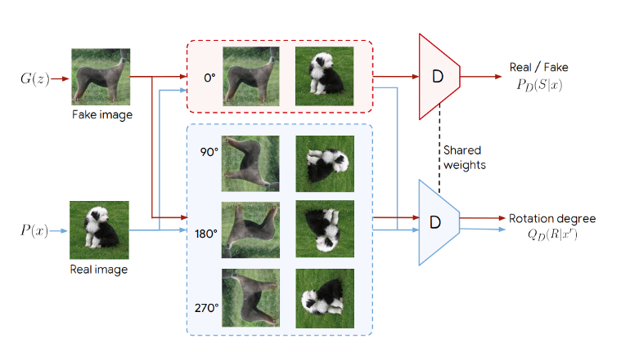
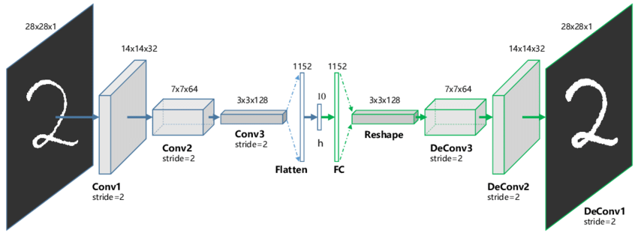
Generative Approach
Generate or otherwise model pixels in the input space
Loss measured in the output space
Pixel-level generation is computationally expensive
Instead, learn high-level features sufficient enough to distinguish different objects
Generating images of high-fidelity may not be necessary for representation learning
Autoencoder
Self-Supervised GANs via Auxiliary Rotation Loss
(Chen Ting et al.)
https://icml.cc/media/Slides/icml/2020/virtual(no-parent)-14-14-00UTC-6762-a_simple_framew.pdf
https://ankeshanand.com/blog/2020/01/26/contrative-self-supervised-learning.html
5
Notes:
Dollar bill countless number of times, we don’t retain a full representation of it. In fact, we really only retain enough features of the bill to distinguish it from other objects.
Representation learning algorithms that don’t concentrate on pixel-level details, and only encode high-level features sufficient enough to distinguish different objects?

Slide 6
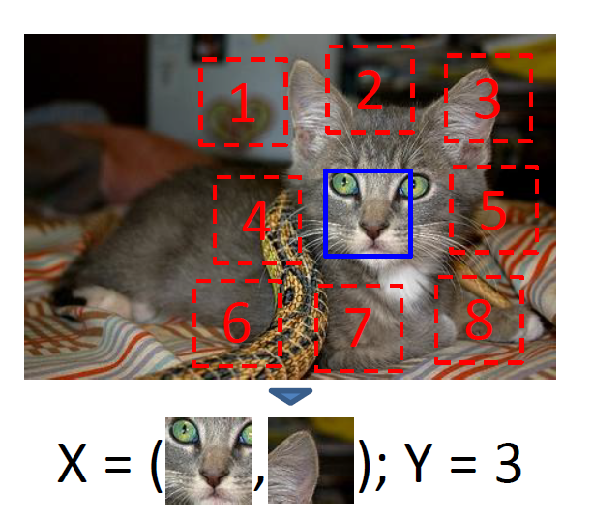
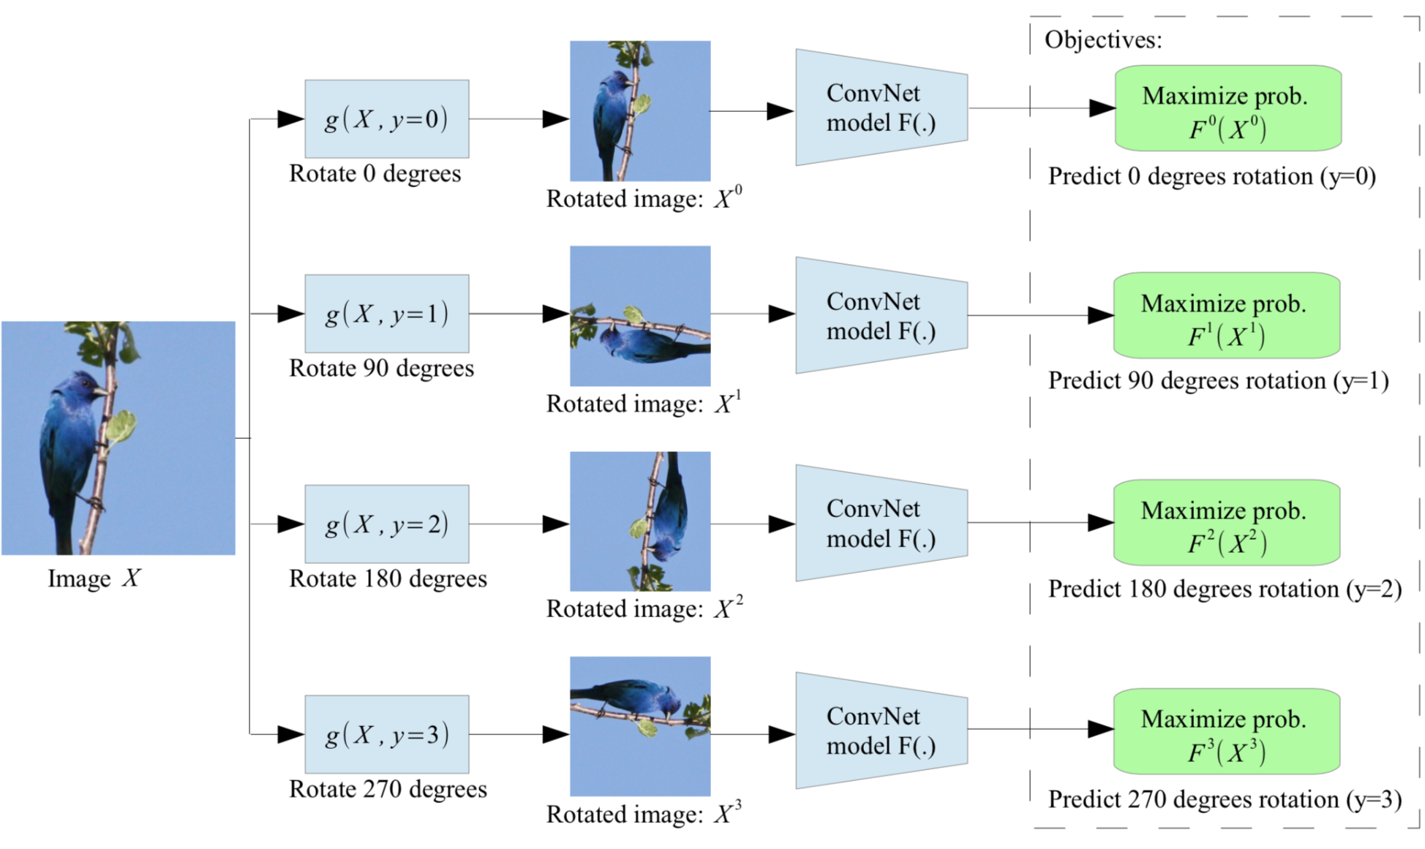
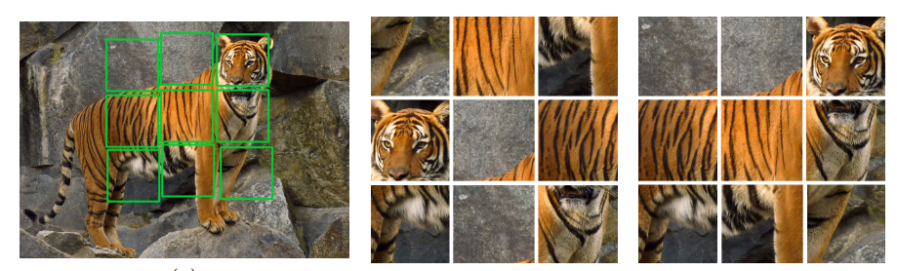
Discriminative Approach (Pretext task)
Train networks to perform pretext tasks where both the inputs and labels are derived from an unlabelled dataset.
Heuristic-based pretext tasks: relative patch location prediction, rotation prediction, solving jigsaw puzzle etc.
Unsupervised Visual Representation Learning by Context Prediction
(Carl Doersch et al.)
Unsupervised Representation Learning by Predicting Image Rotations
(Spyros Gidaris et al.)
Unsupervised Learning of Visual Representations by Solving Jigsaw Puzzles
(Mehdi Noroozi et al.)
https://icml.cc/media/Slides/icml/2020/virtual(no-parent)-14-14-00UTC-6762-a_simple_framew.pdf
6

Slide 7
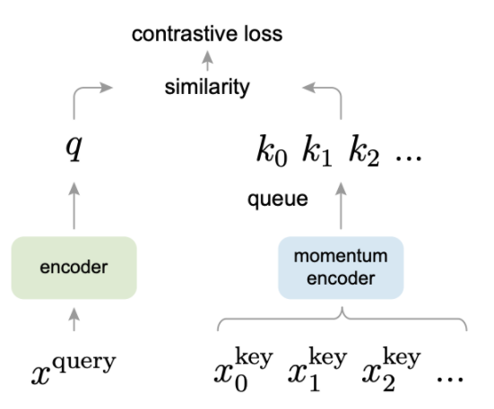
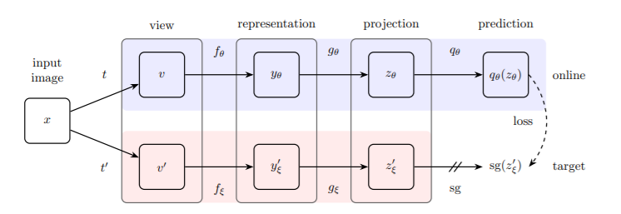
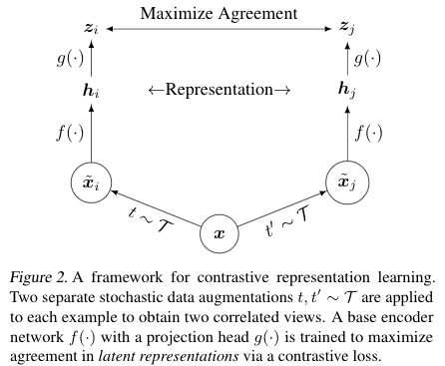
Discriminative Approach (Contrastive learning)
Contrastive learning: to classify images on the basis of similarity and dissimilarity
Contrastive learning in latent space
Methods: MoCo, SimCLR, BYOL, SwAV etc.
Momentum Contrast for Unsupervised Visual Representation Learning
(Kaiming He et al.)
A Simple Framework for Contrastive Learning of Visual Representations
(Chen Ting et al.)
Bootstrap Your Own Latent
A New Approach to Self-Supervised Learning
(Jean-Bastien Gril et al.)
https://icml.cc/media/Slides/icml/2020/virtual(no-parent)-14-14-00UTC-6762-a_simple_framew.pdf
7
Notes:
MoCo : dictionary look-up task,
The “keys” (tokens) in the dictionary are sampled from data (e.g., images or patches) and are represented by an encoder network. Unsupervised learning trains encoders to perform dictionary look-up: an encoded “query” should be similar to its matching key and dissimilar to others. Learning is formulated as minimizing a contrastive loss. Slowly progressing key encoder, implemented as a momentum-based moving average of the query encoder, is
Make representation independent of augmentation
Pretext task: Instance discrimination task

Slide 8
SimCLR
Concept, Implementation & Key Findings

Slide 9
A Simple Framework for Contrastive Learning of Visual Representations
Aim: Maximize the agreement of representations under data transformation, using a contrastive loss in the latent/feature space
Two separate data augmentation operators are sampled from the same family of augmentations and applied to each data example to obtain two correlated views.
A base encoder network f(·) and a projection head g (·) are trained to maximize agreement using a contrastive loss.
After training is completed, we throw away the projection head g (·) and use encoder f(·)and representation h for downstream tasks.
https://ai.googleblog.com/2020/04/advancing-self-supervised-and-semi.html
9

Slide 10
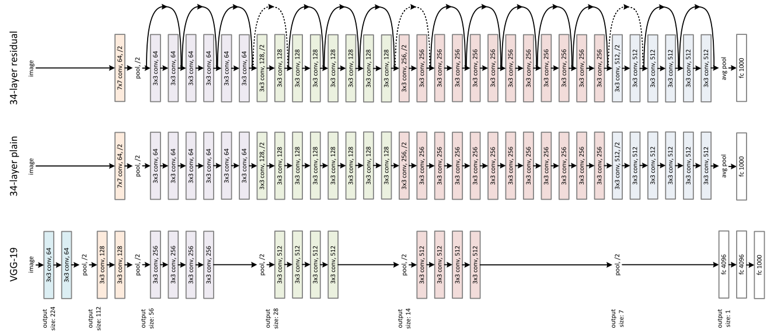
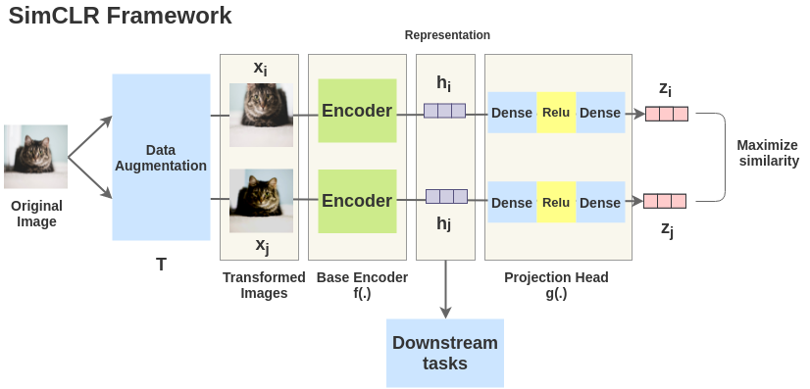
Implementation details
Network
Base encoder: ResNet-50
Projection head: 2-layer MLP head
128-dimensional latent space
Batch size
256-8192
Batch size of 8192 gives 16382 negative examples per positive pair from both augmentation views
No memory bank
Optimizer
LARS (Layer-wise Adaptive Rate Scaling) optimizer
SGD/Momentum may be unstable for large batch sizes
Linear warmup for 10 epochs and decay LR with cosine decay schedule without restarts
Others
Epochs: 100, 200, 400, 800
Global Batch Normalization
Cloud TPUs using 32 to 128 cores
Dataset: ImageNet ILSVRC-2012
Notes:
LARS
Scale learning rate dynamically according to grad norm.
BN:
Compute BN statistics over all cores
In distributed training with data parallelism, the BN mean and variance are typically aggregated locally per device. In our contrastive learning, as positive pairs are computed in the same device, the model can exploit the local information leakage to improve prediction accuracy without improving representations.
ResNet-50 in 3 different hidden layer widths (width multipliers of (1x, 2x, 4x). Intra-batch communication among samples (caused by BN) leaks information.
The two encoders shown below have shared weights
Training set: 1000 categories and 1.2 million images
Val/Test set: 1000 categories and 150,000 photographs

Slide 11
Key Findings
Loss function: Representation learning with contrastive cross entropy loss benefits from normalized embeddings and an appropriately adjusted temperature parameter.
Data Augmentation: Composition of multiple data augmentation operations is crucial in defining the contrastive prediction tasks that yield effective representations.
Projection head: Learnable nonlinear transformation between the representation and the contrastive loss substantially improves the quality of the learned representations
Batch Size & Epochs: Contrastive learning benefits from larger batch sizes and longer training compared to its supervised counterpart.
Notes:
LARS
Scale learning rate dynamically according to grad norm.
BN: Compute BN statistics over all cores
In distributed training with data parallelism, the BN mean and variance are typically aggregated locally per device. In our contrastive learning, as positive pairs are computed in the same device, the model can exploit the local information leakage to improve prediction accuracy without improving representations.
ResNet-50 in 3 different hidden layer widths (width multipliers of (1x, 2x, 4x)
Training set: 1000 categories and 1.2 million images
Val/Test set: 1000 categories and 150,000 photographs

Slide 12
Contrastive Loss function
Mathematical notation, Intuition
& Parameters

Slide 13
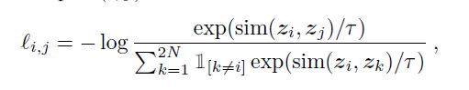
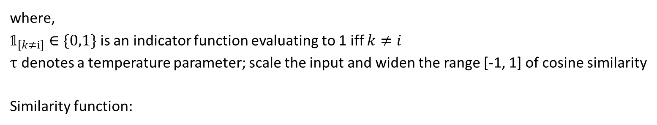
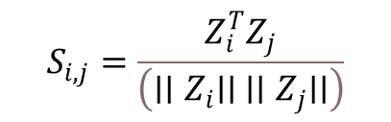
NT-Xent (normalized temperature-scaled cross entropy loss)
where,
$𝟙_{\left[k≠i\right]}∈\{0,1\}$ is an indicator function evaluating to 1 iff $k≠i$
$τ$ denotes a temperature parameter; scale the input and widen the range [-1, 1] of cosine similarity
Similarity function:
$$S_{i,j}=\frac{Z_{i}^{T}Z_{j}}{\left({∣∣Z}_{i}∣∣{ ∣∣Z}_{j}∣∣\right)}$$
13

Slide 14
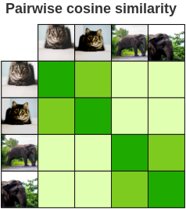
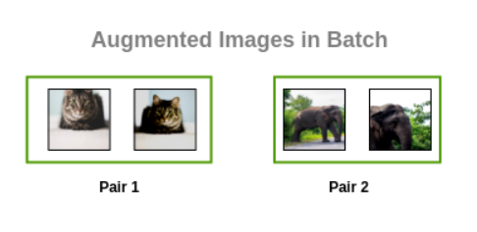
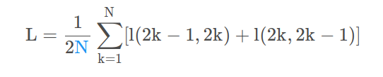
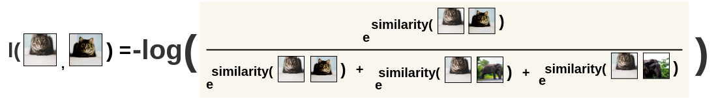
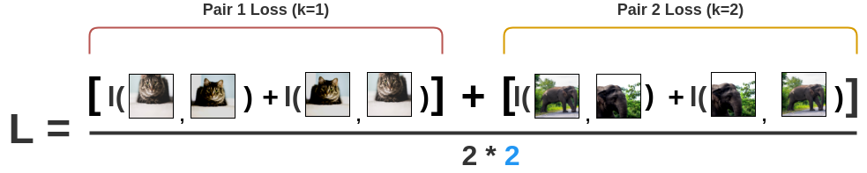
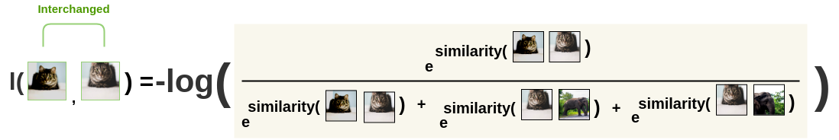
Intuition
Take each pair
Calculate similarity
Total loss function
Calculate SoftMax
https://amitness.com/2020/03/illustrated-simclr/
14
Notes:
For each image in this batch, a random transformation function is applied to get a pair of 2 images. Thus, for a batch size of 2, we get 2*N = 2*2 = 4 total images.
First, the augmented pairs in the batch are taken one by one
Next, we apply the softmax function to get the probability of these two images being similar
This softmax calculation is equivalent to getting the probability of the second augmented cat image being similar to the first cat image in the pair.
Here, all remaining images in the batch are sampled as a dissimilar image (negative pair).
Then, the loss is calculated for a pair by taking the negative of the log of the above calculation.
Finally, we compute loss over all the pairs in the batch of size N=2 and take an average.
Based on the loss, the encoder and projection head representations improves over time and the representations obtained place similar images closer in the space.

Slide 15
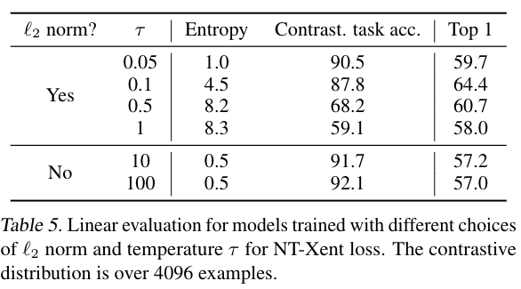
Parameters
Key parameters for the loss function:
Normalized Embedding
Temperature
Effect
Without normalization and proper temperature scaling performance is significantly worse
Without L2 norm, contrastive accuracy is higher but resulting representation is worse under linear evaluation.
15

Slide 16
Data Augmentation Projection Head Batch Size & Epochs

Slide 17
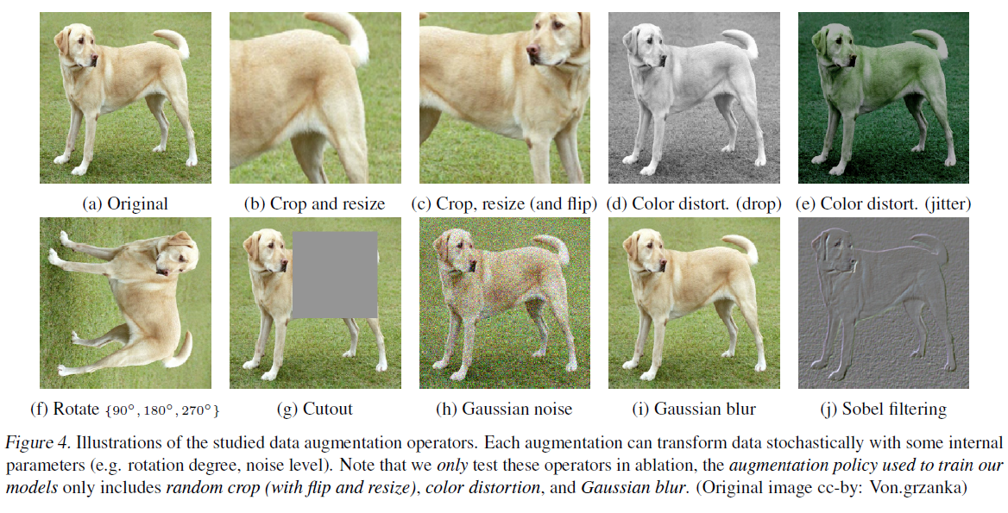
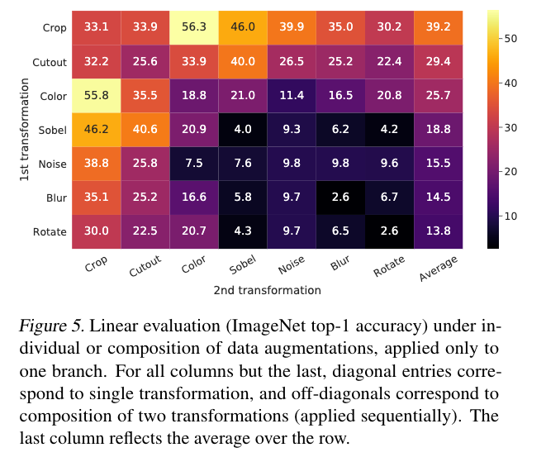
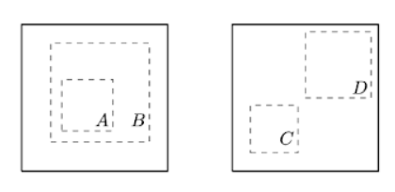
Data Augmentation
Unsupervised contrastive learning benefits from stronger (colour) data augmentation than supervised learning.
Composition of data augmentation operations is crucial for learning good representations
Applying data augmentation to a single branch hurts the performance but the model can almost perfectly identify the positive pairs in the contrastive task
Random cropping with random colour distortion compass two types of prediction tasks that enable effective representation learning:
predicting local views (crop A) from a larger, “global” view (crop B)
predicting neighbouring views (e.g., between crop C and crop D)
Notes:
Different crops of the same image usually look very similar in color space.
If the colors are left intact, a model can maximize agreement between crops simply by matching the color histograms. In this case, the model might focus solely on color and ignore other more generalizable features.
By independently distorting the colors of each crop, these shallow clues can be removed, and the model can only achieve agreement by learning useful and generalizable representations.

Slide 18
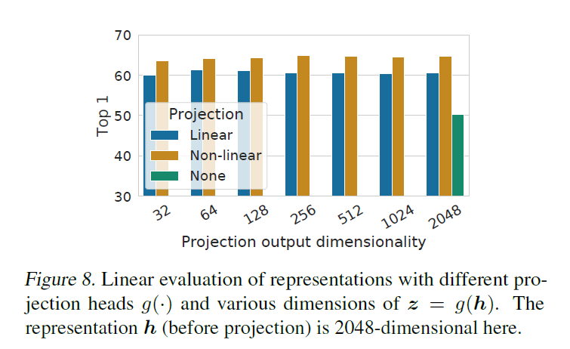
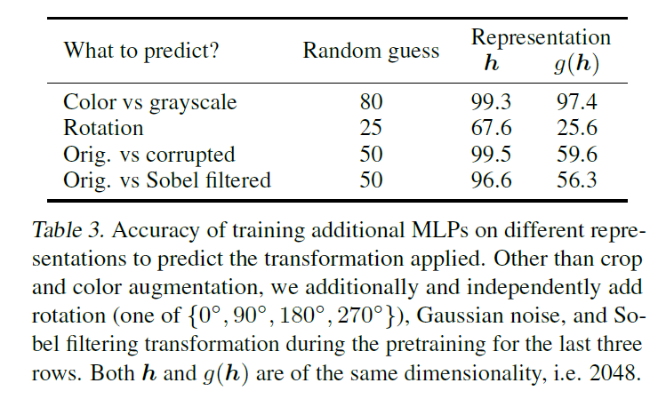
Projection Head
A nonlinear projection head improves the representation quality of the layer before it
Nonlinear projection is better than a linear projection (+3%) and much better than no projection (>10%)
Compared three projection head g(.) (after average pooling of ResNet):
Identity mapping
Linear projection
Nonlinear projection with one additional hidden layer (ReLU activation)
Notes:
LARS
Scale learning rate dynamically according to grad norm.
BN: Compute BN statistics over all cores
In distributed training with data parallelism, the BN mean and variance are typically aggregated locally per device. In our contrastive learning, as positive pairs are computed in the same device, the model can exploit the local information leakage to improve prediction accuracy without improving representations.
ResNet-50 in 3 different hidden layer widths (width multipliers of (1x, 2x, 4x)
Training set: 1000 categories and 1.2 million images
Val/Test set: 1000 categories and 150,000 photographs

Slide 19
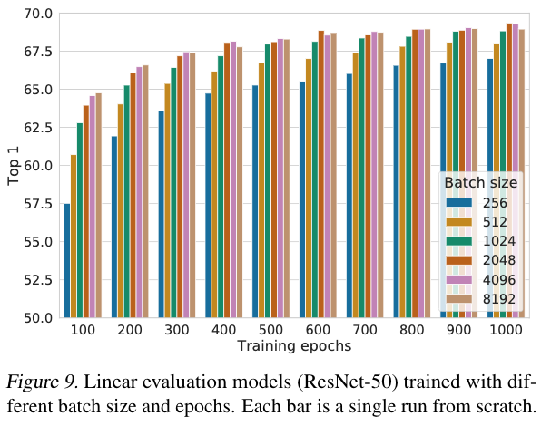
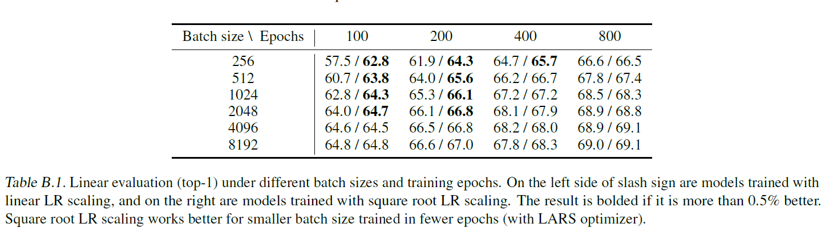
Batch Size & Epochs
Contrastive learning benefits from larger batch sizes and longer training
Notes:
LARS
Scale learning rate dynamically according to grad norm.
BN: Compute BN statistics over all cores
In distributed training with data parallelism, the BN mean and variance are typically aggregated locally per device. In our contrastive learning, as positive pairs are computed in the same device, the model can exploit the local information leakage to improve prediction accuracy without improving representations.
ResNet-50 in 3 different hidden layer widths (width multipliers of (1x, 2x, 4x)
Training set: 1000 categories and 1.2 million images
Val/Test set: 1000 categories and 150,000 photographs

Slide 20
Results
Comparison:
Other self-supervised Learning Methods
Supervised Learning

Slide 21
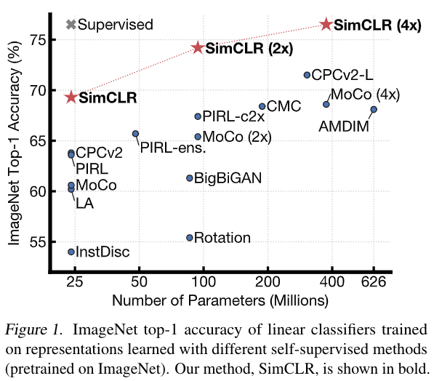
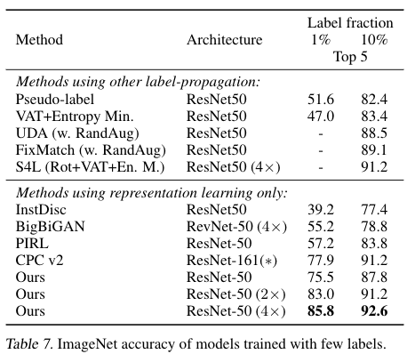
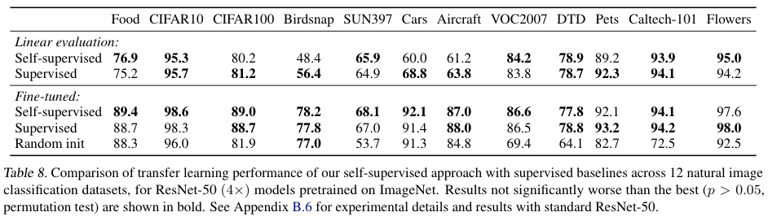
Comparing with other Self-Supervised Methods
Linear evaluation
Semi-Supervised
Comparing with Supervised Learning
Notes:
logistic regression classifier is trained to classify a new dataset based on the self-supervised representation learned on ImageNet,
Supervised
Outperforms on 5 datasets, whereas the supervised baseline is superior on only 2*. On the remaining 5 datasets, the models are statistically tied.

Slide 22
References
Papers
https://arxiv.org/abs/2002.05709
https://arxiv.org/abs/1911.05722
Blogs
https://ai.googleblog.com/2020/04/advancing-self-supervised-and-semi.html
https://amitness.com/2020/03/illustrated-simclr/
https://ankeshanand.com/blog/2020/01/26/contrative-self-supervised-learning.html
https://paperswithcode.com/method/simclr
Implementations
https://colab.research.google.com/github/KeremTurgutlu/self_supervised/blob/master/nbs/10%20-%20simclr.ipynb
https://colab.research.google.com/drive/1UK8BD3xvTpuSj75blz8hThfXksh19YbA?usp=sharing
https://github.com/google-research/simclr

Slide 23
QnA

Slide 24
Thank You!!

